Slide 1
CS4038
DATA MINING
LECTURE # 13
SPRING 2024
FAST – NUCES, CFD CAMPUS
AYESHA LIAQAT
ayesha.liaqat#@nu.edu.pk

Slide 2
TODAY’S TOPICS
Nearest neighbor classifier
Kd-tree (continued)

Slide 3

ILLUSTRATING CLASSIFICATION TASK
Tid | Attrib1 | Attrib2 | Attrib3 | Class
1 | Yes | Large | 125K | No
2 | No | Medium | 100K | No
3 | No | Small | 70K | No
4 | Yes | Medium | 120K | No
5 | No | Large | 95K | Yes
6 | No | Medium | 60K | No
7 | Yes | Large | 220K | No
8 | No | Small | 85K | Yes
9 | No | Medium | 75K | No
10 | No | Small | 90K | Yes
Learning algorithm
Induction
Learn Model
10
Training Set
Model
Apply Model
Tid | Attrib1 | Attrib2 | Attrib3 | Class
11 | No | Small | 55K | ?
12 | Yes | Medium | 80K | ?
13 | Yes | Large | 110K | ?
14 | No | Small | 95K | ?
15 | No | Large | 67K | ?
Deduction
10
Test Set

Slide 4
NEAREST NEIGHBOR CLASSIFIER
Unknown record
Requires three things
The set of stored records
Distance Metric to compute distance between records
The value of k, the number of nearest neighbors to retrieve
To classify an unknown record:
Compute distance to other training records
Identify k nearest neighbors
Use class labels of nearest neighbors to determine the class label of unknown record (e.g., by taking majority vote)

Slide 5
FINDING NEAREST NEIGHBOR USING KD-TREE

Slide 6
NEAREST NEIGHBOR SEARCH
kd-tree (k-dimensional tree)
A data structure for answering nearest neighbor queries in R²
kd-tree construction algorithm
Select the x or y dimension (alternating between the two)
Partition the space into two with a line passing from the median point
Repeat recursively in the two partitions as long as there are enough points

Slide 7
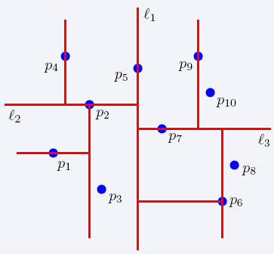
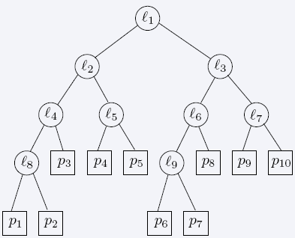
NEAREST NEIGHBOR SEARCH
The idea is to split the search space so that we do not have to visit
2-dimensional kd-trees
Is it really important to alternate between different
DATA MINING - FALL 2022
7
to find nearest neighbors.
dimensions while slicing/cutting the search space?

Slide 8
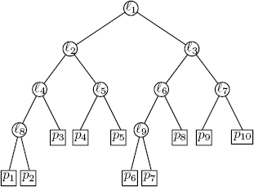
KD TREE
A k-dimensional tree is a binary tree.
Example: data stored at the leaves

Slide 9
KD TREE (CONT’D)
Every node (except leaves) represents a hyperplane that divides the space into two parts.
Points to the left (right) of this hyperplane represent the left (right) sub-tree of that nod
e.
Pleft
Pright

Slide 10
KD TREE CONSTRUCTION
If there is just one point, form a leaf with that point.
Otherwise, divide the points in half by a line perpendicular to one of the axes.
Recursively construct k-d trees for the two sets of points.
Division strategies:
divide in a round-robin fashion (alternating the axes).
divide points perpendicular to the axis with widest spread.

Slide 11
KD TREE (CONT’D)
As we move down the tree, we divide the space along alternating (but not always) axis-aligned hyperplanes:
Split by x-coordinate: split by a vertical line that has (ideally) half the points left or on, and half right.
Split by y-coordinate: split by a horizontal line that has (ideally) half the points below or on and half above.
Almost half: take median of the values

Slide 12
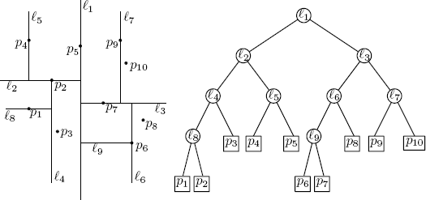







KD TREE - EXAMPLE
Split by y-coordinate: split by a horizontal line that has half the points below or on and half above.
x
y
y
x
x
x
x
y
y
15

Slide 13
KD TREE
A binary search tree where every node is a k-dimensional point.
Example: k=2
53, 14
27, 28
65, 51
30, 11
31, 85
70, 3
99, 90
29, 16
40, 26
7, 39
32, 29
82, 64
38, 23
15, 61
55,62
73, 75

Slide 14
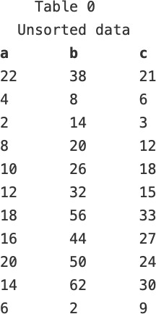
PRACTICE WORK
Use median value to split, attribute splitting order: b, c, a

Slide 15
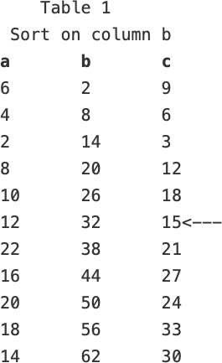
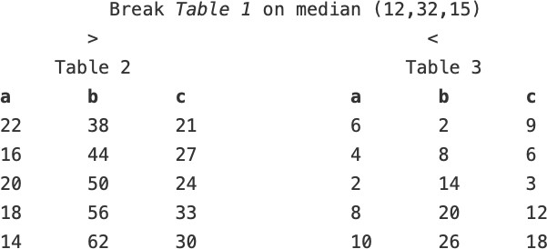
3-DIMENSIONAL TREE EXAMPLE
Median

Slide 16
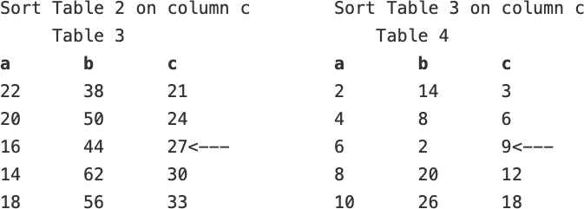
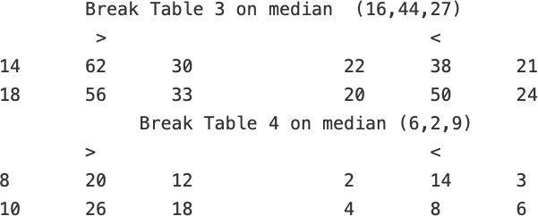
3-DIMENSIONAL TREE EXAMPLE
Median
Median
If stopping criteria is not met: Split on attribute a, Split on attribute b, then c, …
20

Slide 17
3-DIMENSIONAL TREE EXAMPLE
Median
Median
If stopping criteria is not met: Split on attribute a, Split on attribute b, then c, …
21
How can we find the nearest neighbor of point (9,25,16)?

Slide 18
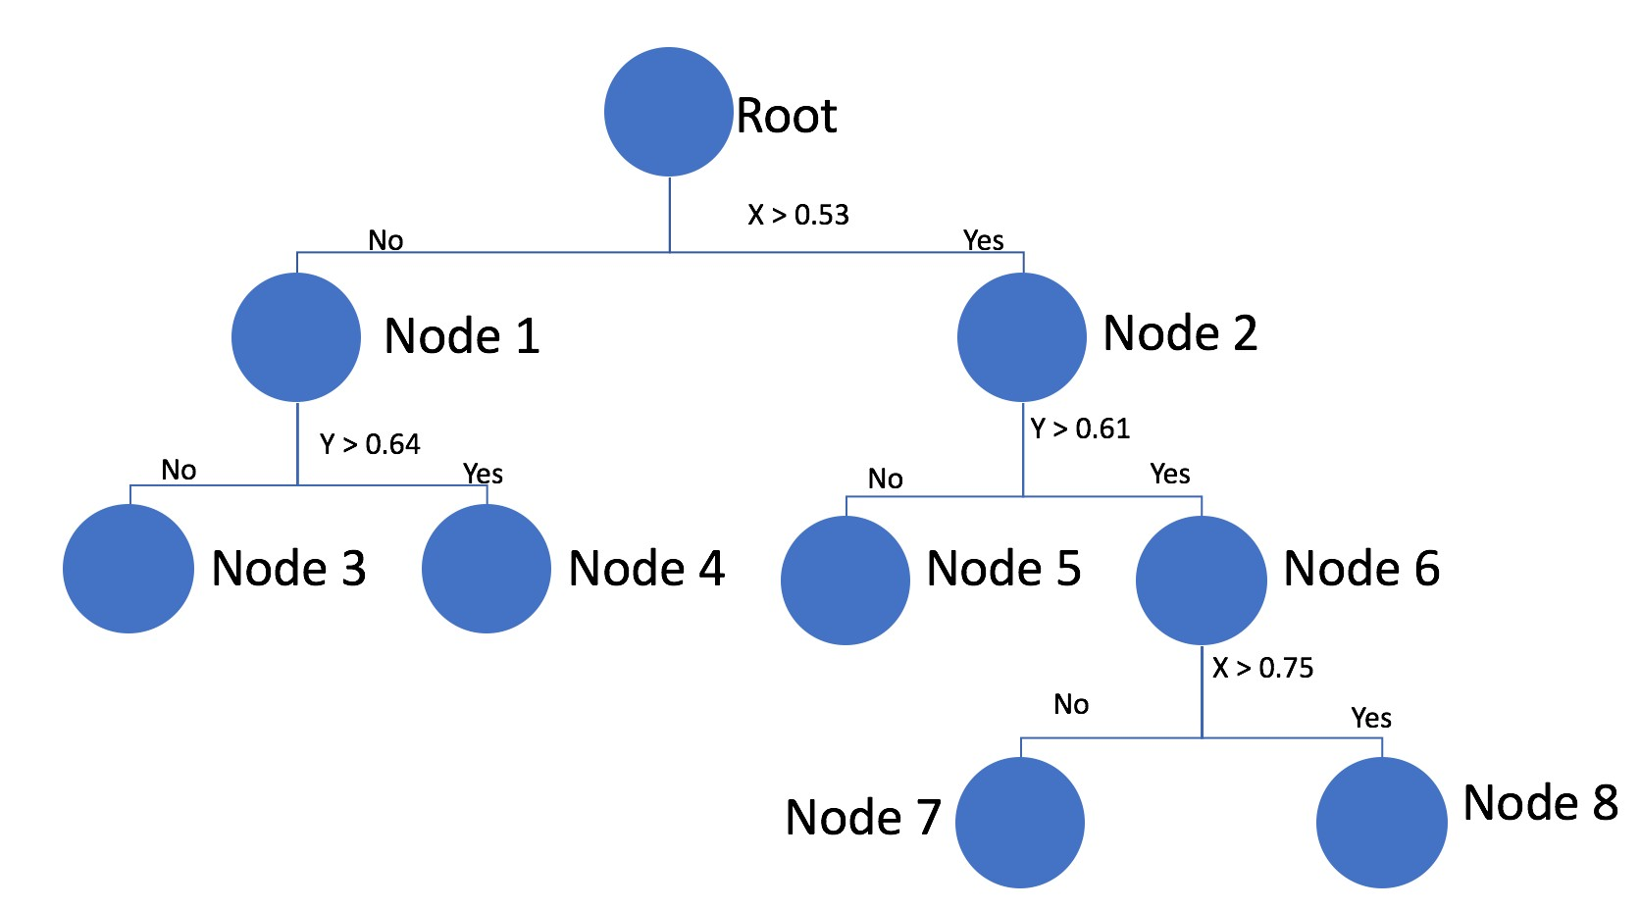
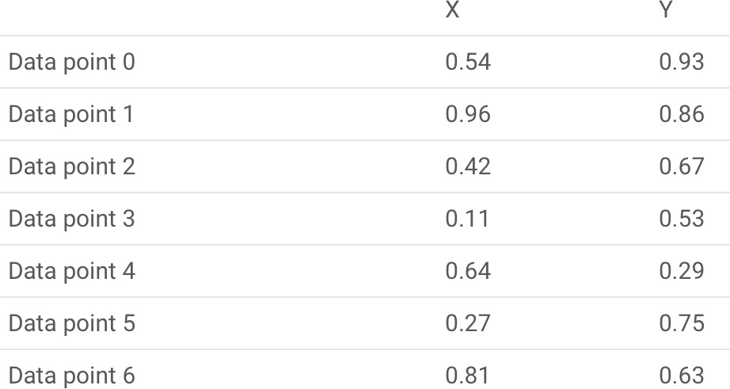
KD-TREE EXAMPLE
Input data
Splitting is performed on mean of max and min values.
We keep on splitting until we get maximum of two data points in a node.
Given a KD-tree, we can identify the region which will contain nearest neighbors for a new data point which we would like to classify.

Slide 19
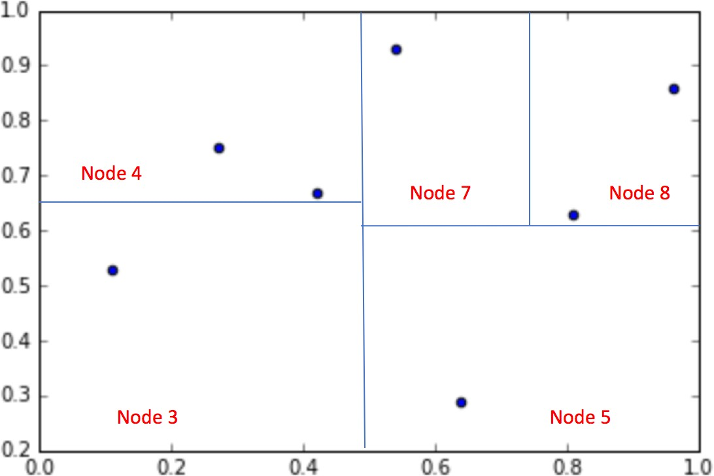
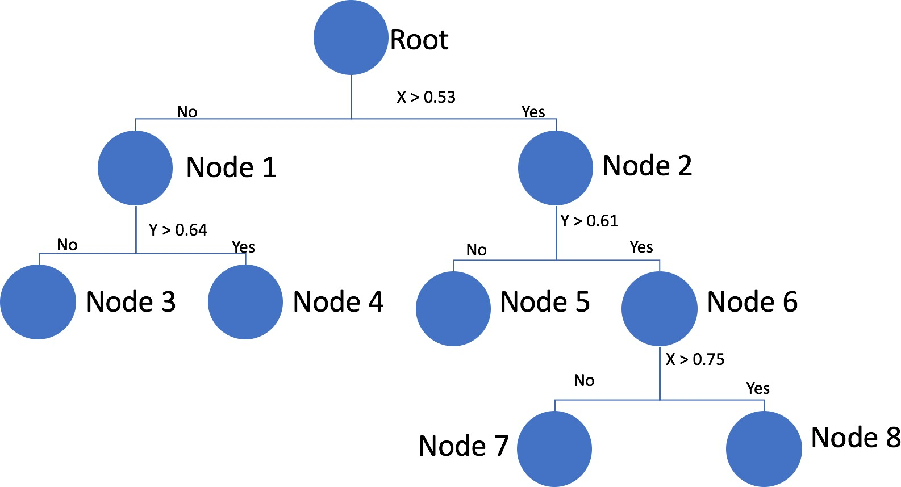
KD-TREE EXAMPLE
But are we certain that all the nearest neighbors lie in the same region as suggested by a KD-tree?

Slide 20
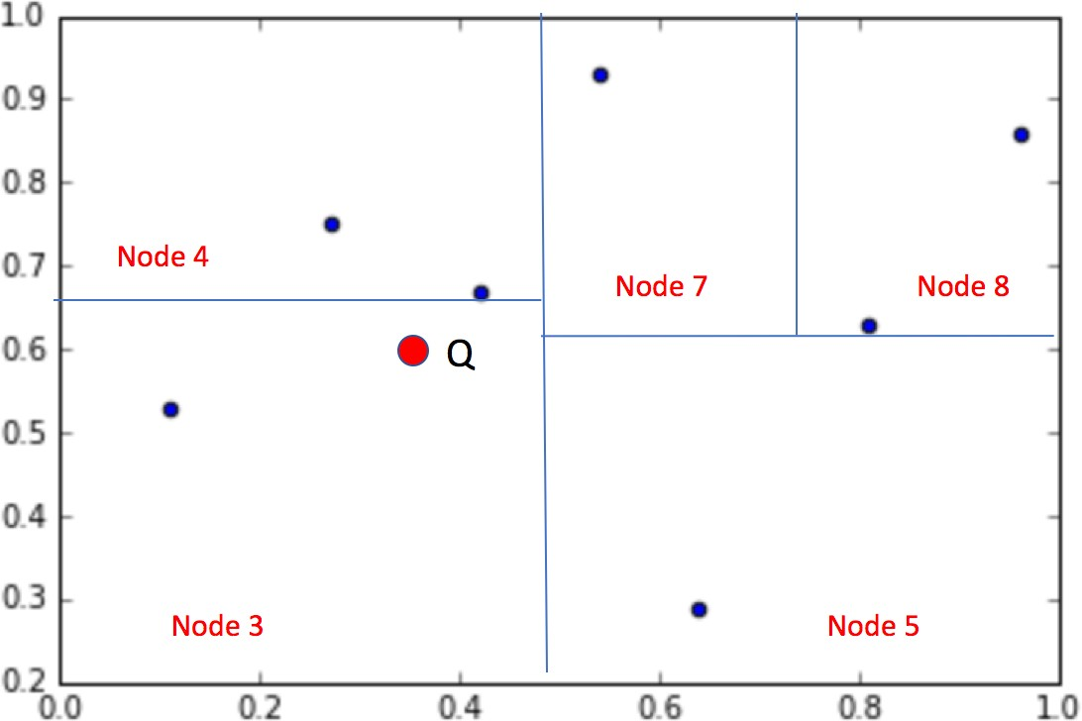
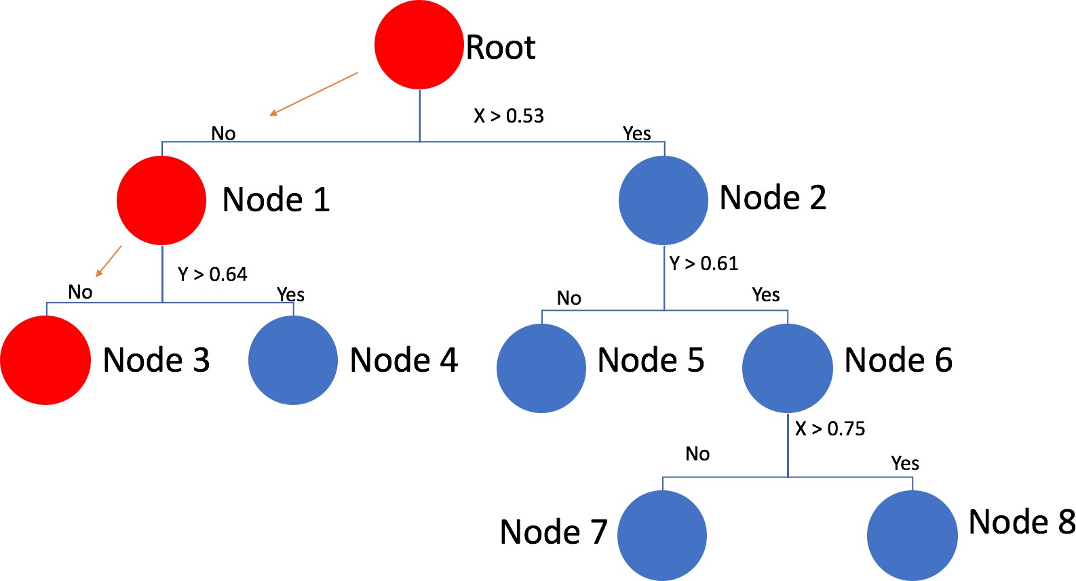
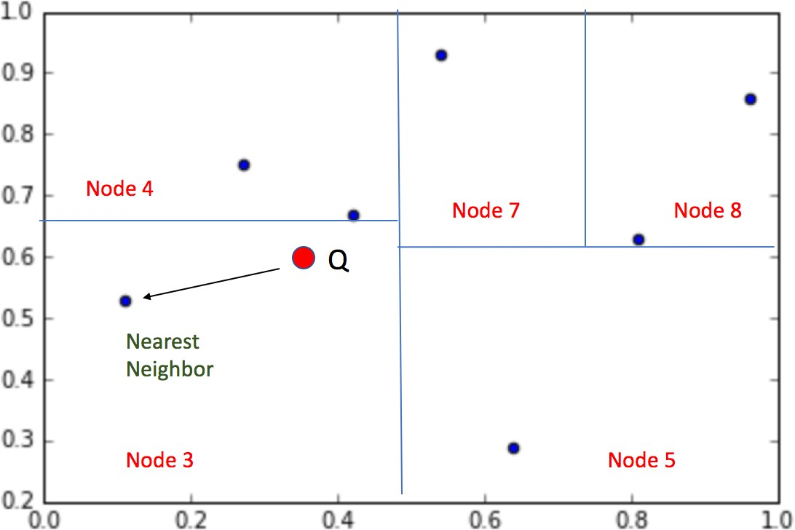
KD-TREE EXAMPLE
1. Let’s say, Q is a point for which we have to find the nearest neighbors
2. We traverse the tree to find the right node.
3. We find the nearest neighbor in Node 3.
Can we say that all the nearest neighbors lie in the same region as suggested by a KD-tree?
Notes:
0.38,0.61

Slide 21
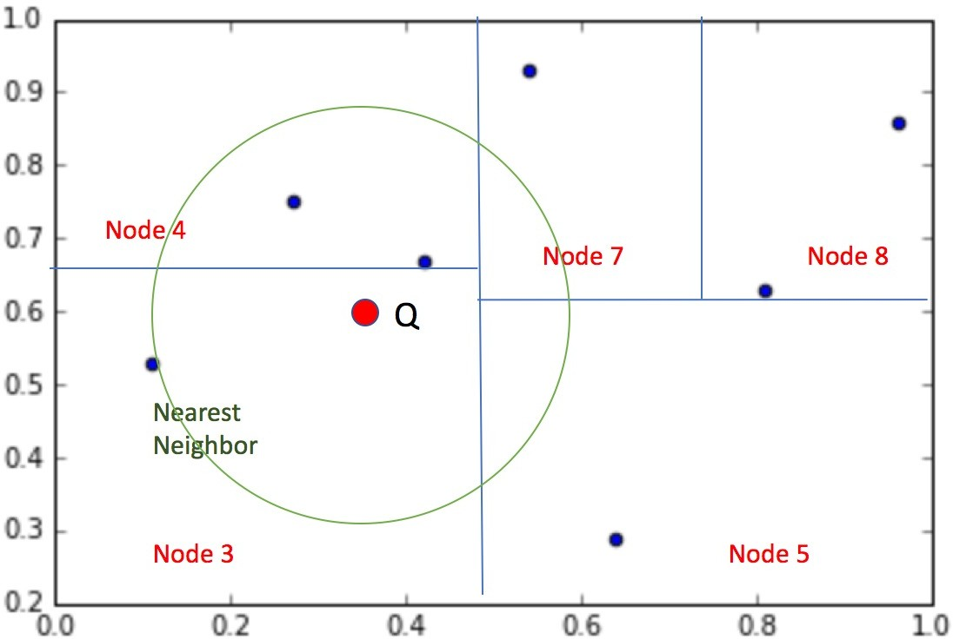
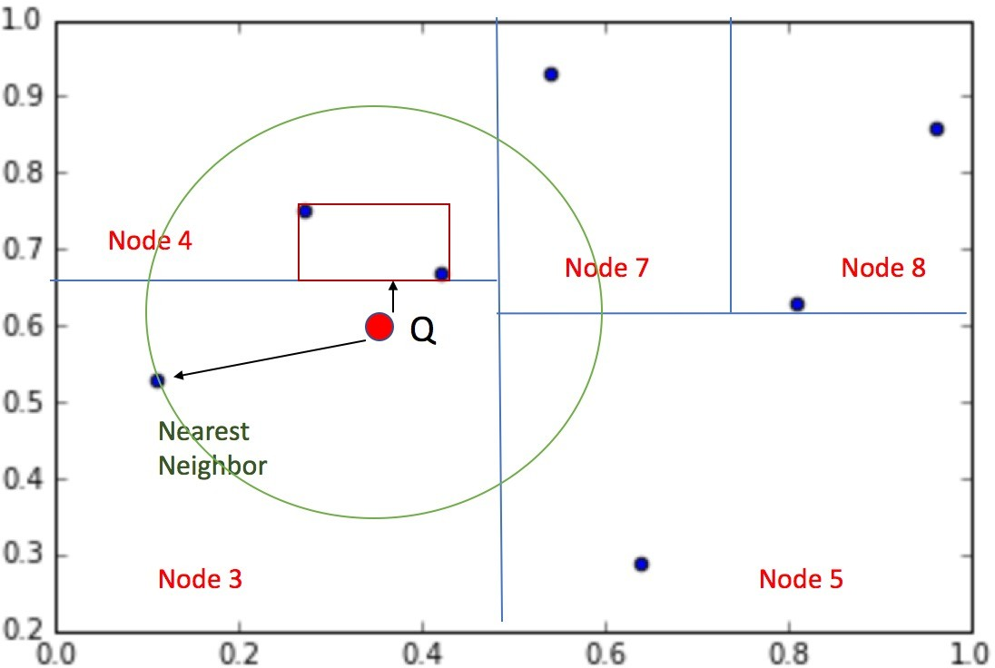
KD-TREE EXAMPLE
5. Traverse one level up to Node 1.
4. We can see that it is not in fact the nearest neighbor to point Q
Do we need to inspect all the remaining data points in Node 1?
The bounding box for Node 4 lies within the circle, indicating that Node 4 may contain a point that’s closer to the query.
25
6. We can better check the tightest box containing all the data points of node N4. Is it closer than the current point or not?

Slide 22
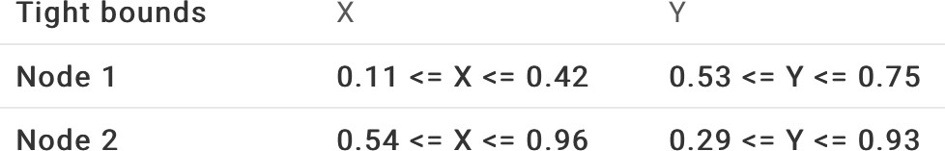
KD-TREE EXAMPLE
Input data
Splitting is performed on mean of max and min values.
We keep on splitting until we get maximum of two data points in a node.
Hence, at each node, we will save three things:
Dimension we split on
Value we split on
•
Tightest bounding box which contains all the points within that node
26

Slide 23
KD-TREE EXAMPLE
5. Traverse one level up to Node 1.
4. We can see that it is not in fact the nearest neighbor to point Q
Do we need to inspect all the remaining data points in Node 1?
The bounding box for Node 4 lies within the circle, indicating that Node 4 may contain a point that’s closer to the query.
27
6. We can better check the tightest box containing all the data points of node N4. Is it closer than the current point or not?

Slide 24
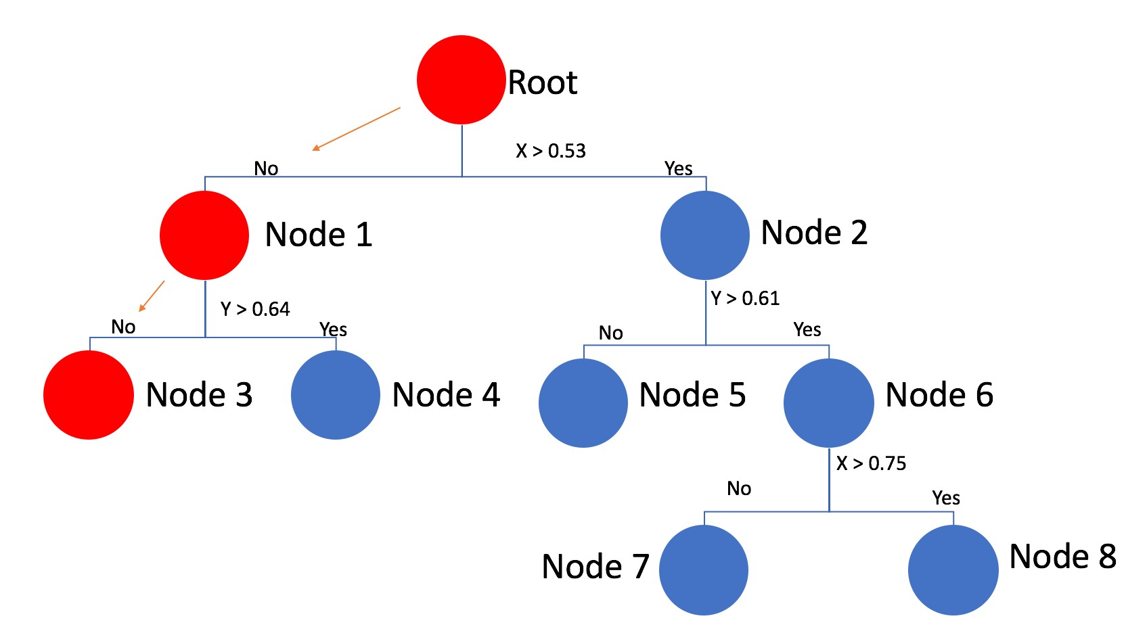
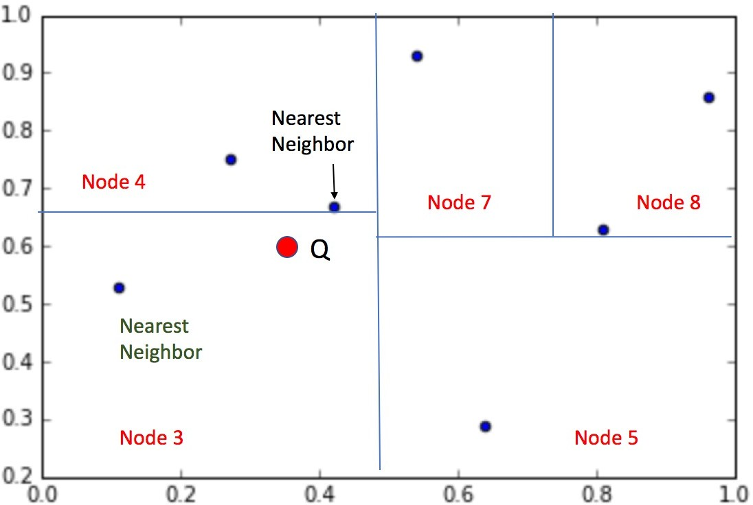
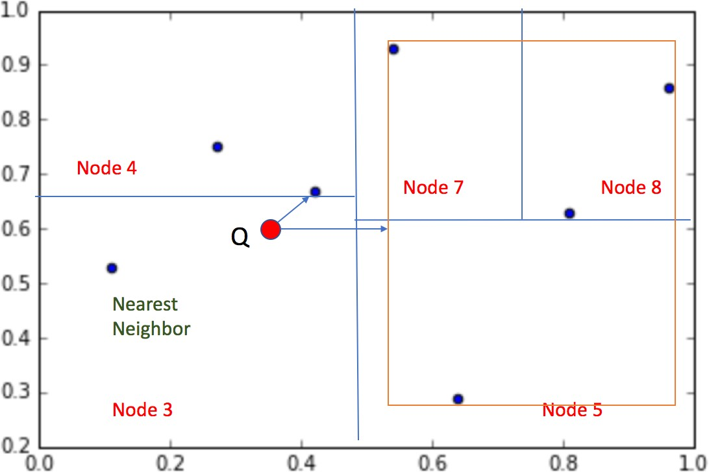
KD-TREE EXAMPLE
8. Now, traverse one level up to
7. After computing distance of the points within Node 4 and comparing with the previous closest point, we find a better neighbor point.
Root.
Do we need to inspect all the remaining data points in Node 2?
We still cannot be sure if this is the only closest neighbor. Hence, repeat the same method.
We can see that the Tightest box is far from the current Nearest point. Hence, we can prune that part of the tree.
28
9. We can better check the tightest box containing all the data points of node N2. Is it closer than the current point or not?

Slide 25
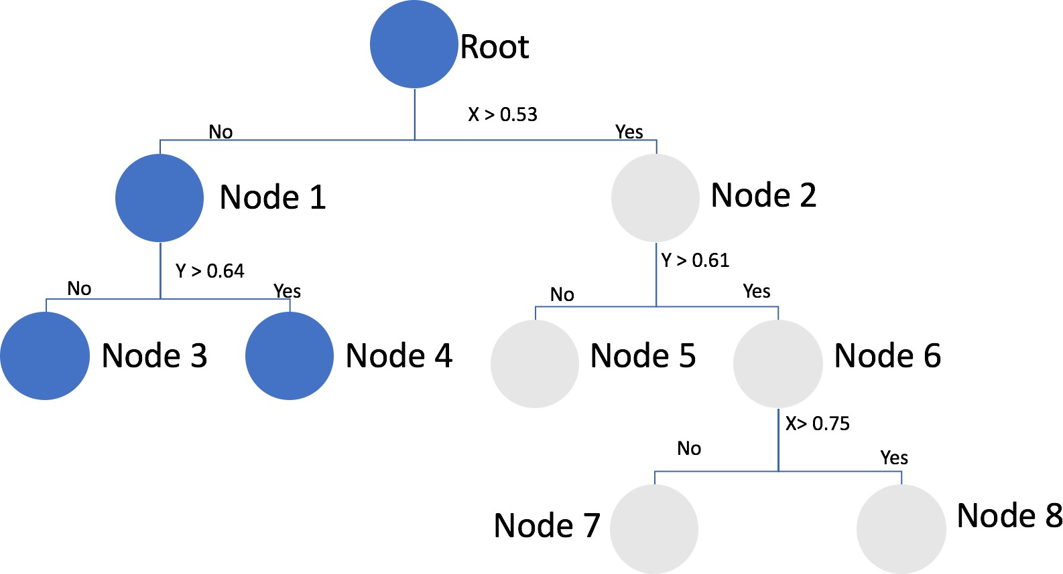
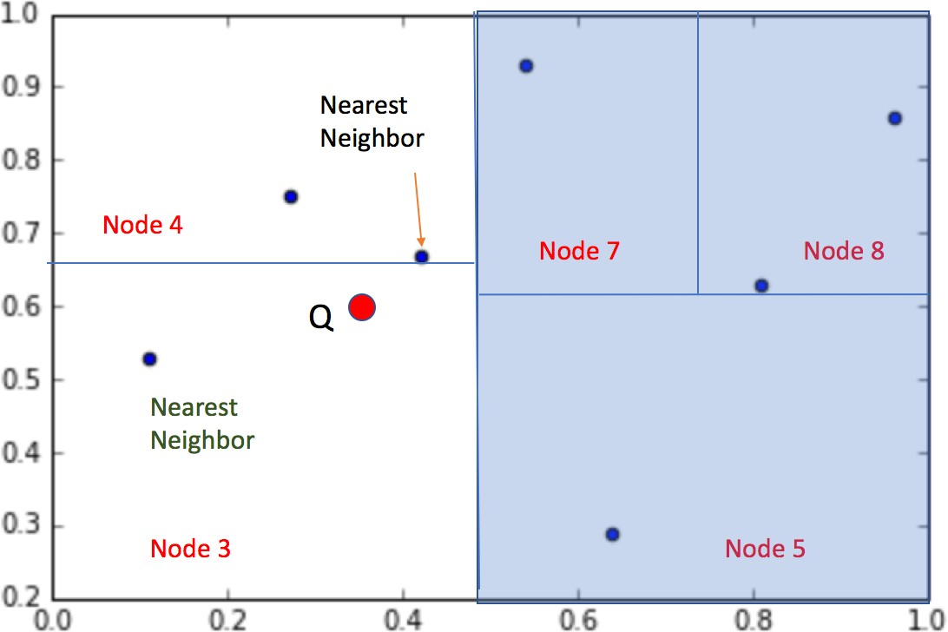
KD-TREE EXAMPLE
Since we’ve traversed the whole tree, we are done; data point marked is indeed the true nearest neighbour of the query.

Slide 26
KD-TREES NEAREST NEIGHBOR
Idea: traverse the whole tree, BUT make two modifications to prune the search space:
Keep variable of closest point C found so far. Prune subtrees once their bounding boxes say that they can’t contain any point closer than C
Search the subtrees in order that maximizes the chance for pruning

Slide 27
KD-TREES SUMMARY
Three important concepts that reoccur in the nearest neighbor searching:
storing partial results: keep best so far, and update
pruning: reduce search space by eliminating irrelevant trees
traversal order: visit the most promising subtree first
Generalizes to d dimensions

Slide 28
KD-TREES SUMMARY
K-dimensional binary trees
Size O(n)
Construction time O(n log n)
Query time: worst case O(n), but for many cases O(log n)
In practice, runtime is closer to:
O(2^{d} + log n)
log n to find cells “near” the query point
2d to search around cells in that neighbourhood

Slide 29
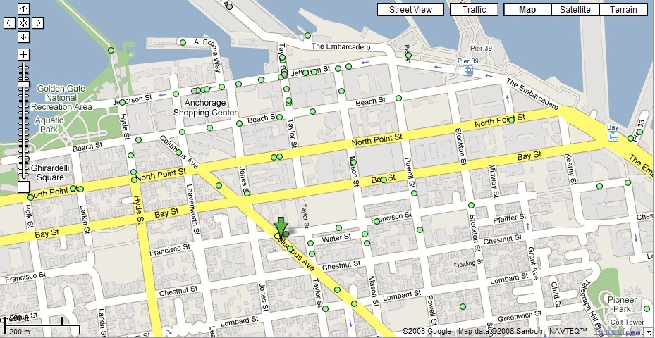
NEAREST NEIGHBOR(S) QUERY
Find the 4 closest restaurants to my hotel

Slide 30
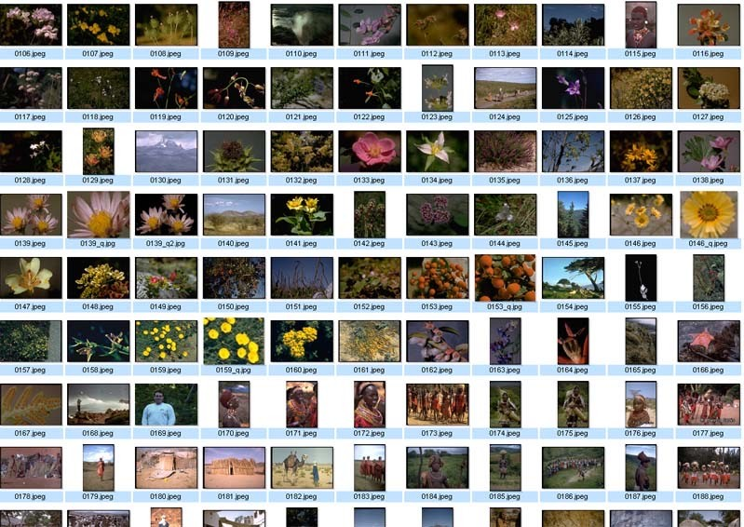

NEAREST NEIGHBOR QUERY IN HIGH DIMENSIONS
Very important and practical problem!
Image retrieval
find N closest matches (i.e., N nearest neighbors)
(f₁,f₂, .., f_{k})

Slide 31
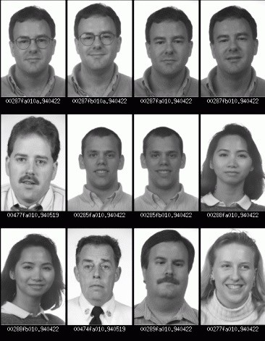

NEAREST NEIGHBOR QUERY IN HIGH DIMENSIONS
Face recognition
find closest match (i.e., nearest neighbor)

Slide 32
DIVISION/SPLITTING STRATEGIES
Divide based on order of point insertion
Assumes that points are given one at a time.
Divide by finding median
Assumes all the points are available ahead of time.
Divide perpendicular to the axis with widest spread
Split axes might not alternate
… and more

Slide 33
READING MATERIAL
Chapter 5:Tan, Steinbach & Kumar
Chapter 8: Han, Kamber & Pei
Chapter 10: D. Larose & C. Larose
Articles on KNN:
https://towardsdatascience.com/k-nearest-neighbor-85bd50ea3e4d
https://www.analyticsvidhya.com/blog/2018/03/introduction-k-neighbours-algorithm- clustering/
Articles on KD-Trees:
https://www.analyticsvidhya.com/blog/2017/11/information-retrieval-using-kdtree/
https://ashokharnal.wordpress.com/2015/01/20/a-working-example-of-k-d-tree-formation- and-k-nearest-neighbor-algorithms/

